Slide 1
US Wildfires 1992-2015
73265 Final Project Presentation
Group Members:
Saleh Ahsan Sakir, Uzair Umar, Mohammad Shaheer

Slide 2
OUTLINE
Introduction
Motivation
Data Collection & Cleaning
Data Cleaning Pipeline
Dashboard Demo
Analysis
Limitations

Slide 3
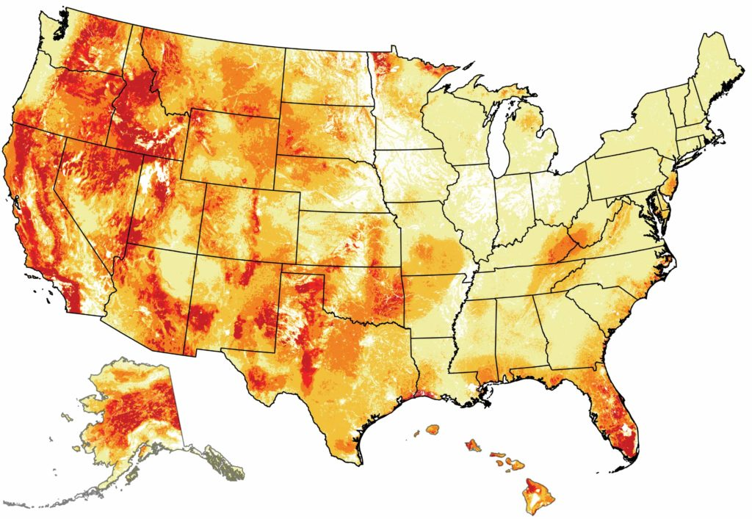


MOTIVATION
Climate Change?????
Increased wildfire activity
In West Cost?
Is New York better at its wildfire planning?
Is Georgia vulnerable to more wildfires in coming years?
Provides key insights to government officials, land and fire management officials
Strategic fire management Planning
Notes:
24 year data
Explanatory analysis and predictive analysis

Slide 4
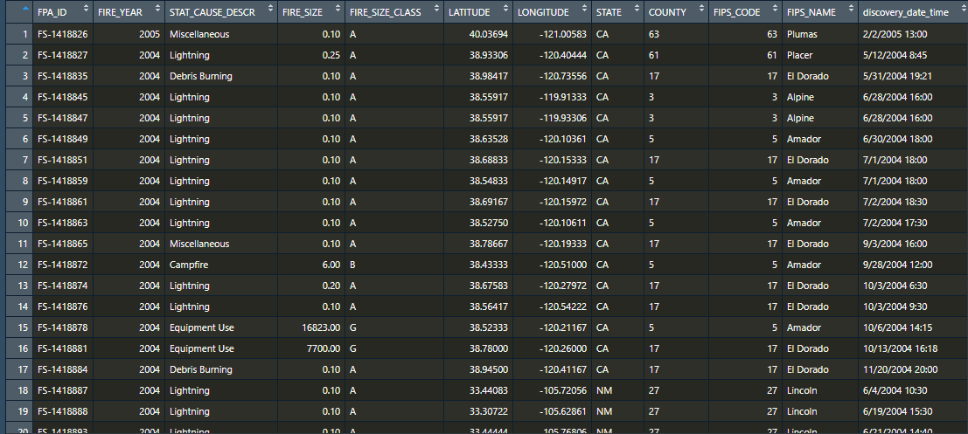
Data Collection & Cleaning
What is the dataset source and purpose?
Dataset collected from Kaggle
National Fire Program Analysis
Pre Cleaning
Post Cleaning
1.88 Million records (rows)
50 Variables
581087 records (rows)
14 variables
Notes:
The wildfire records were acquired from the reporting systems of federal, state, and local fire organizations
Support national fire program analysis

Slide 5
Data Cleaning Pipeline
Filter rows with NA values
Remove unused variables
Restructure some variable values
1.88 M rows
581,087 rows
Notes:
The wildfire records were acquired from the reporting systems of federal, state, and local fire organizations
Support national fire program analysis

Slide 6
Dashboard Demo
Click the link for some cool stuff
<https://youtu.be/suck9j83Xc4>

Slide 7
Analysis
Over the years the wildfires affected more states but the time taken to control the wildfires generally decreased

Slide 8
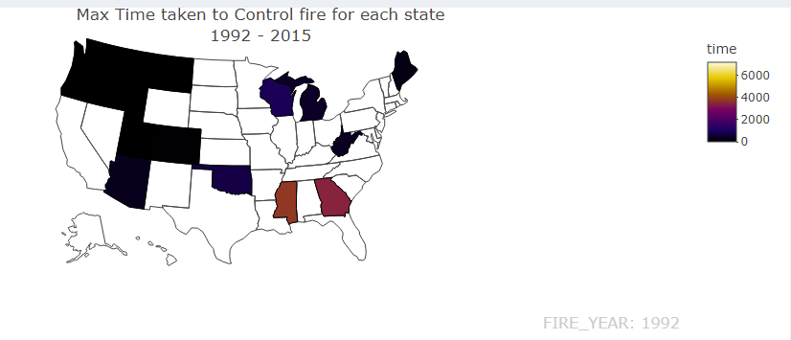
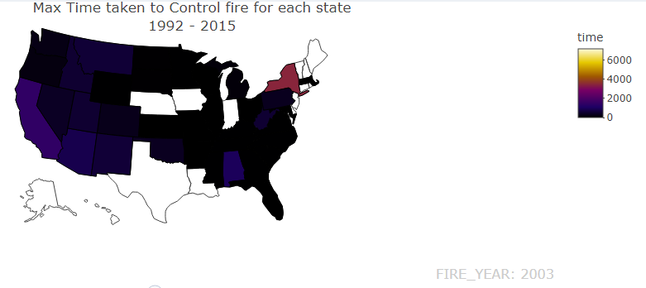
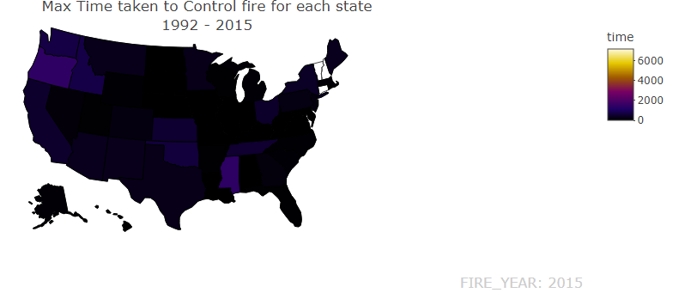

Slide 9
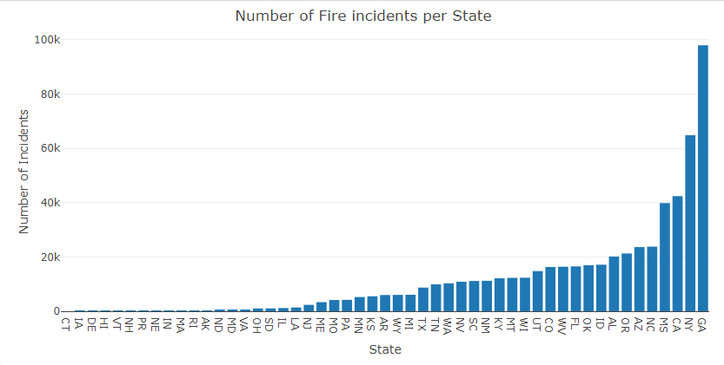
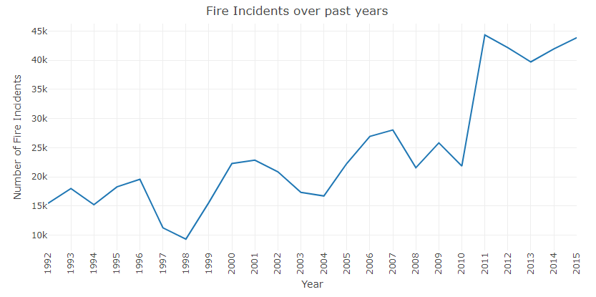
Analysis
Total fire incidents increased over the years
Georgia, New York and California experienced the greatest number of fire incidents

Slide 10
Analysis
Naturally occurring wildfires take more time to control and affect a larger area however human caused wildfires are more frequent

Slide 11
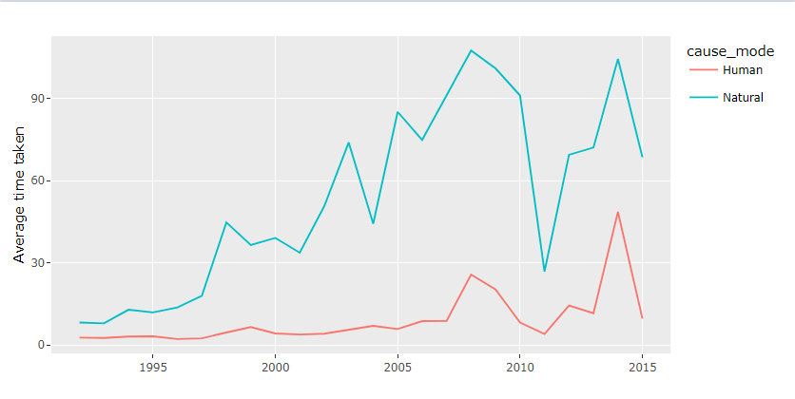
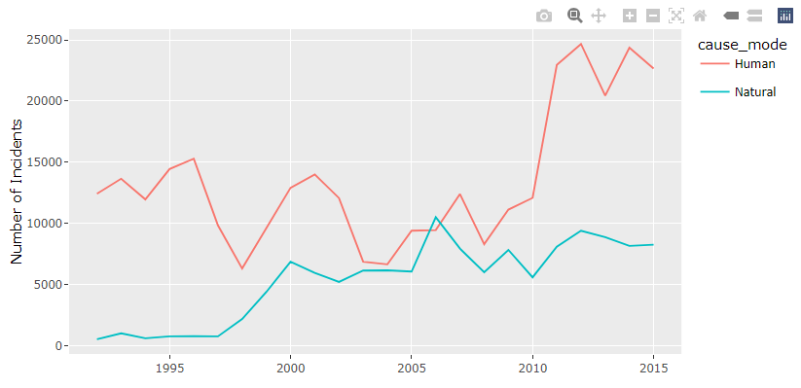
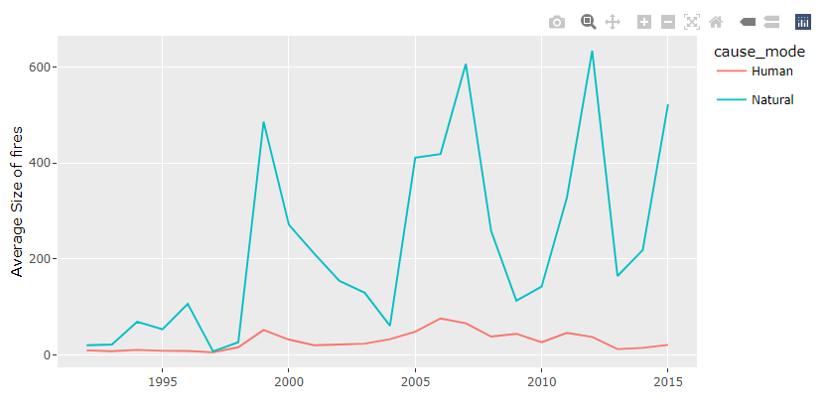

Slide 12
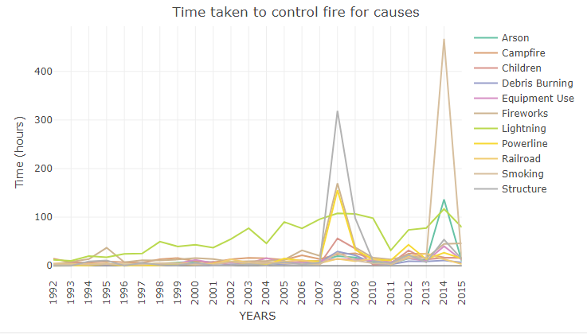
Analysis
Fires caused by lightning take the most time to control

Slide 13
Limitations
Missing Data
Limited data for some states
We cannot conclude that a particular state was more affected by wildfires because there was more data available for it or was it actually more prone to wildfires
Bound to be human errors for fire incidents in earlier years
Fires in remote areas might not be reported

Slide 14
References
Short, Karen C. 2017. Spatial wildfire occurrence data for the United States, 1992-2015 [FPA_FOD_20170508]. 4th Edition. Fort Collins, CO: Forest Service Research Data Archive. https://doi.org/10.2737/RDS-2013-0009.4

Slide 15
Thank You!

Slide 16
Questions?

